Slide 1

Introduction to Supercomputing at USD
Doug Jennewein-Director of Research Computing
*Joseph Madison-Research Computing Assistant

Slide 2

Acknowledgements
University of Oklahoma/Oklahoma State University
University of South Dakota – Information Technology Services
University of South Dakota – Department of Chemistry
XSEDE
Richard Stallman

Slide 3
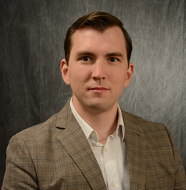

USD Supercomputing Team- Your Partners for Superpowers
Doug Jennewein – Director of Research Computing
Joseph Madison – Research Computing Assistant
Wendi Sapp – Domain Expert, Chemistry
Adam Erck – Domain Expert, Chemistry

Slide 4

Notes:
Poll Title: Have you used the USD HPC? https://www.polleverywhere.com/multiple_choice_polls/S2Z2sTcWsKk8Rl4

Slide 5
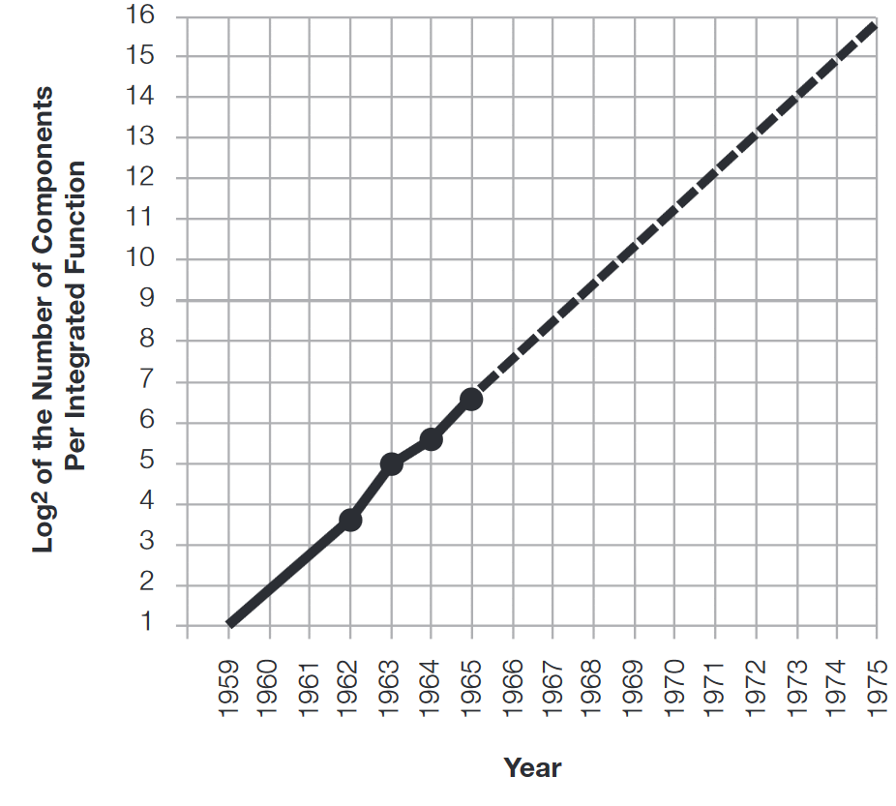
Moore’s Law
?
“Integrated circuits will lead to such wonders as home computers…”
Moore, G. (1965). Cramming More Components Onto Integrated Circuits, Electronics,(38) 8.
Notes:
The observation made in 1965 by Gordon Moore, co-founder of Intel, that the number of transistors per square inch on integrated circuits had doubled every year since the integrated circuit was invented. Moore predicted that this trend would continue for the foreseeable future.

Slide 6
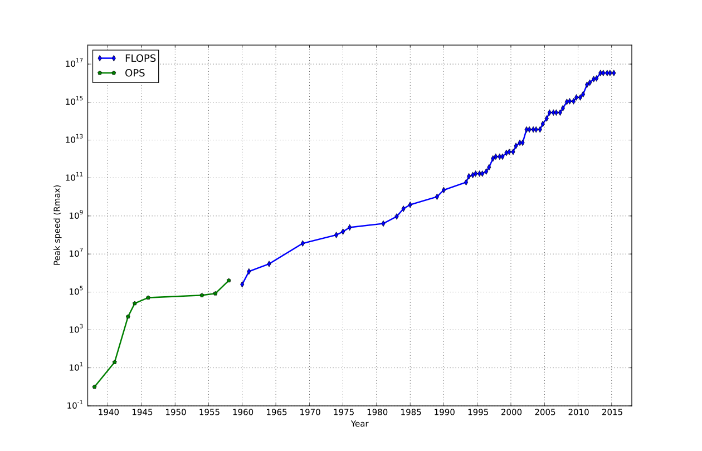
Top Supercomputer speed by year
By Morn - Own work, CC0
Notes:
Flops-floating point operations per second

Slide 7
What is Supercomputing?
Supercomputing is the biggest, fastest computing right this minute. Likewise, a supercomputer is one of the biggest, fastest computers right this minute. So, the definition of supercomputing is constantly changing.
Rule of Thumb: A supercomputer is typically at least 100 times as powerful as a PC.
Jargon: Supercomputing is also known as
High Performance Computing (HPC) or
High End Computing (HEC) or
Cyberinfrastructure (CI).

Slide 8
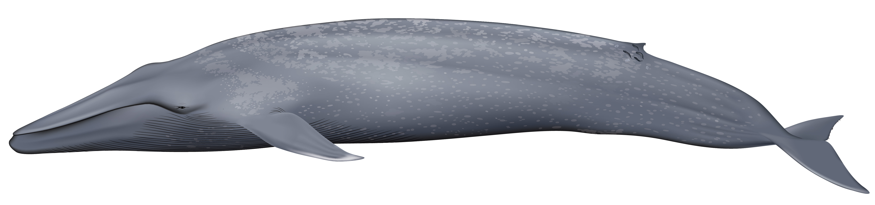

What is Supercomputing About?

Slide 9
What is Supercomputing About?
Size
Problems interesting to researchers need more RAM or disk than you could get on your PC
Speed
Don’t want to wait a month for a job to run on a PC, do it on HPC in a few hours

Slide 10
Why Bother with HPC at All?
Effective use of HPC takes quite a bit of effort, both learning how and developing software.
That seems like a lot of trouble to go to just to get your code to run faster.
It’s nice to have a code that used to take a day, now run in an hour. But if you can afford to wait a day, what’s the point of HPC?
Why go to all that trouble just to get your code to run faster?

Slide 11
Why HPC is Worth the Bother
What HPC gives you that you won’t get elsewhere is the ability to do bigger, better, more exciting science. If your code can run faster, that means that you can tackle much bigger problems in the same amount of time that you used to need for smaller problems.
HPC is important not only for its own sake, but also because what happens in HPC today will be on your desktop in about 10 to 15 years and on your cell phone in 25 years: it puts you ahead of the curve.

Slide 12
The Future is Now
Historically, this has always been true:
Whatever happens in supercomputing today will be on your desktop in 10 –15 years. So, if you have experience with supercomputing, you’ll be ahead of the curve when things get to the desktop.

Slide 13
What is a Supercomputer?
Similar idea to PC, but lots of PCs connected
Each individual “computer” in cluster is referred to as a node
Nodes have to “talk”
Interconnect, software needed

Slide 14
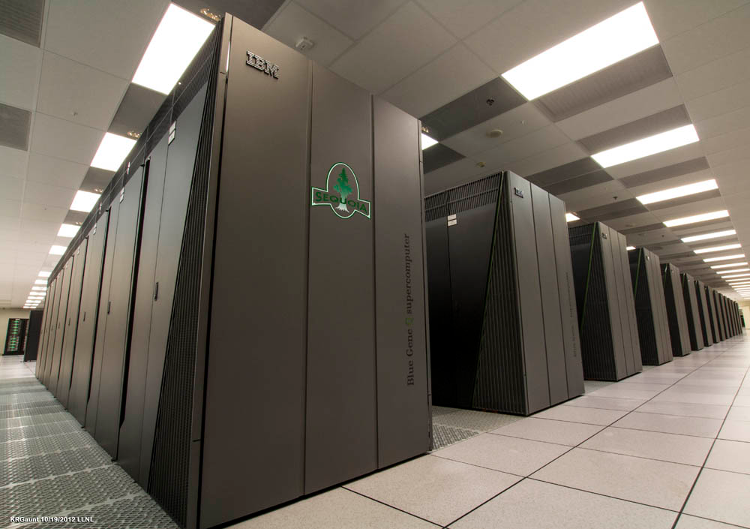
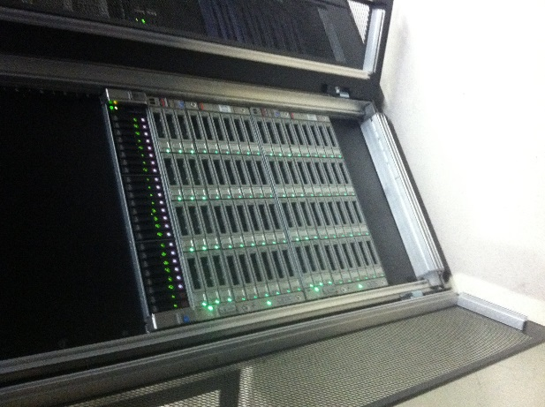
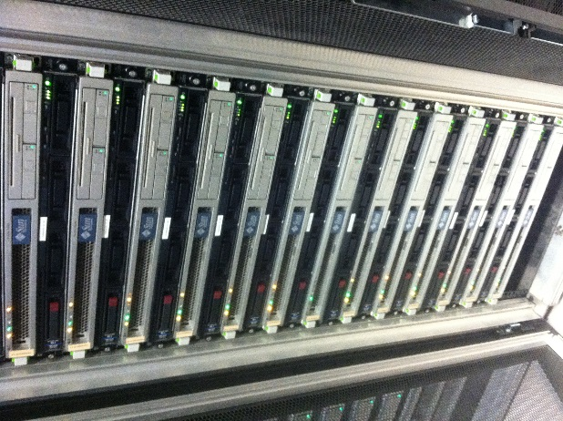
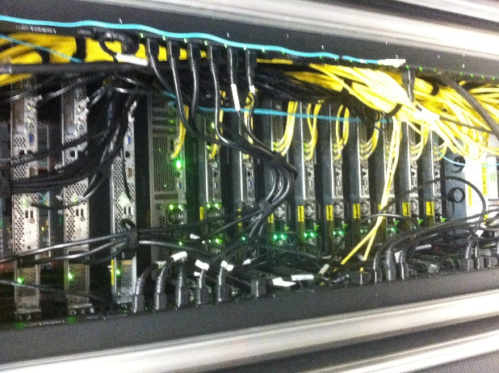
What a Supercomputer Looks like
USD Cluster
IBM - Sequoia
Nodes
Interconnect

Slide 15
Hardware Basics
Central Processing Unit
Primary Storage
Secondary Storage
Input Devices
Output Devices

Slide 16
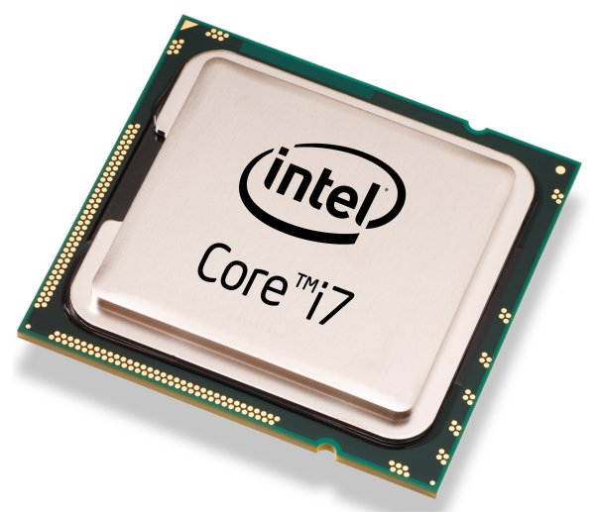
Central Processing Unit
Components
Control Unit – figures out what to do next
Arithmetic/Logic Unit – performs calculations
Registers – data being used right now

Slide 17
Primary Storage
Main memory
RAM
Data being used
Cache
Small memory
About to be used or have been used recently

Slide 18
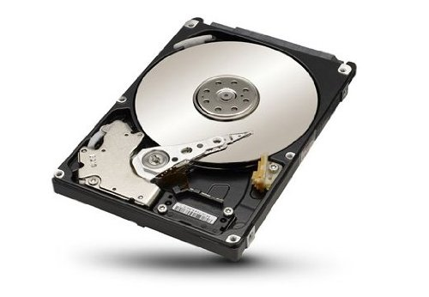
Secondary Storage
Data that can be used in the future
Non-volatile storage
Examples
Blu-Ray
CD
Hard-drive
SSD

Slide 19
Input/Output
Input
Keyboard, mouse
Output
Speakers, printer

Slide 20
Software
Command-line interface
Cygwin/PuTTY (Windows)
Linux terminal
Mac terminal
Domain specific software

Slide 21
Parallelism
Parallelism in software and hardware
Hardware
Cluster, distributed, massively parallel, multi-core
NUMA, UMA
Software
ILP, TLP, DLP
Architecture considerations
Notes:
Instruction level parallelism, data level parallelism, transaction level parallelism; non-uniform memory access (nodes), uniform memory access

Slide 22
The HPC Learning Curve
Programming languages – Python, R, Java, C++, Fortran
Should have a basic understanding of how a computing cluster works
Learning domain specific software
Where do I do this?
Access Online Resources!
Contact the USD Research Computing Team!
Come to our Upcoming Seminar Series!

Slide 23
Are there reasons to learn a computer language other than for using the HPC?
Yes!!!

Slide 24
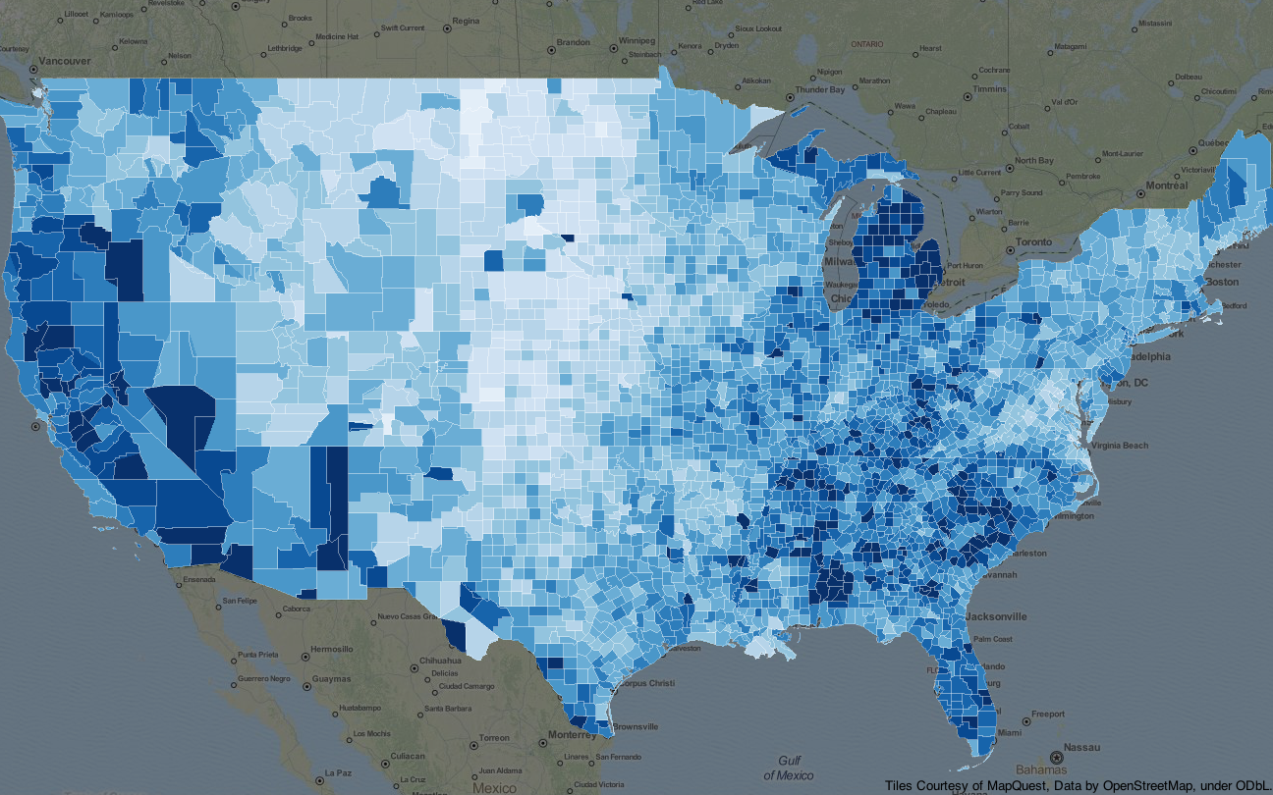
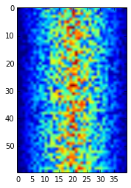
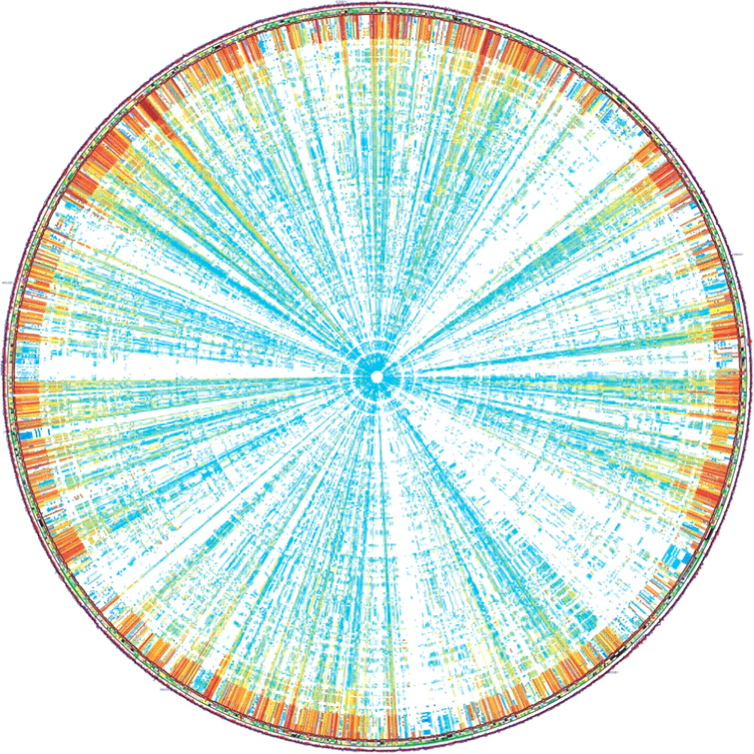
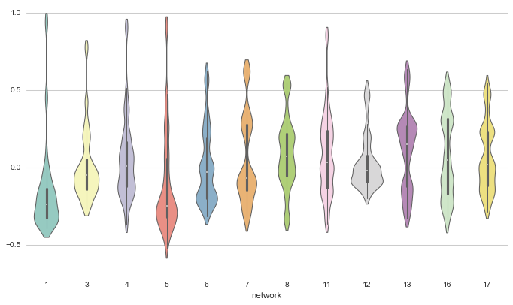
Data visualization using basic Python code
Inflammation Levels
Patient ID
Day

Slide 25

How learning some basic programming can automate your tedious tasks
Problem:
I am writing a report about gender roles and word associations from the early 1800s. I have chosen to look at the six Jane Austen novels as my source of text.
One Solution:
Open each text file and use the ‘Find’ feature to search for words that I choose. I could use a spreadsheet to track words that are adjacent to the selected words.
A Different Way:
Use R to perform text mining in order to get word repetitions, word associations, and multiple word visualizations.

Slide 26

How learning some basic programming can automate your tedious tasks
Problem:
I have a folder full subfolders with multiple data files in each subfolder. I need to feed these files into a program but they are the wrong format. They are also named inconsistently.
One Solution:
Open each folder and file individually in order to resave in the appropriate format. Rename each file one-by-one. This could take hours depending on the number of files in the folder.
A Different Way:
Write a few lines of code that will convert the files and rename them. Writing the code takes 5-10 minutes and the code executes in only a few minutes.

Slide 27
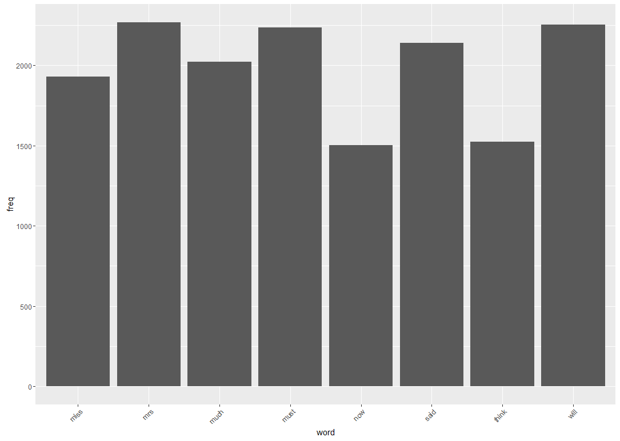

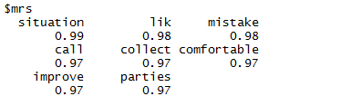
Jane Austen text analysis results
Word Frequency
Graph
Word Clouds
Word Associations

Slide 28
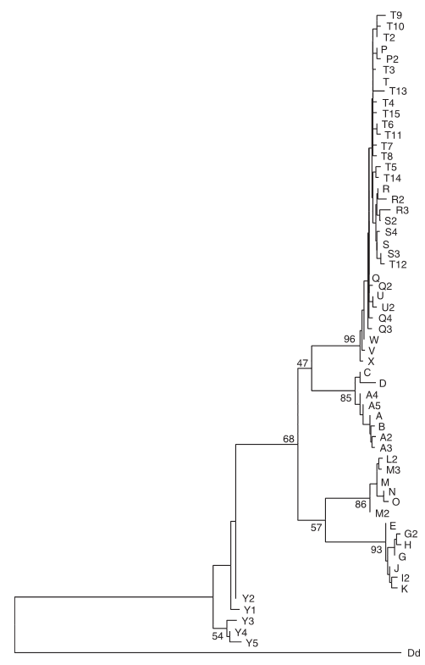
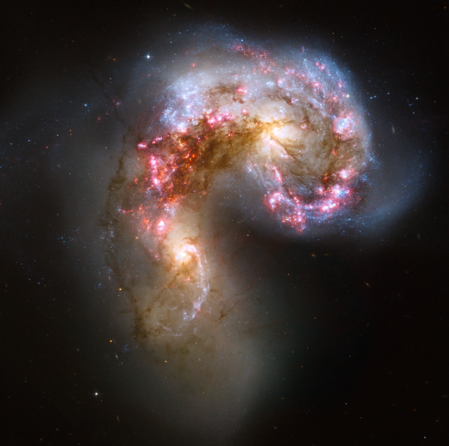
What Things can I use HPC for?
Data Mining
Gene sequencing
Signal processing
Visualization
Lots of data
Simulation
Galaxy formation
Evolution
Weather
Vianna, J. A., et al. (2006). Phylogeography, phylogeny and hybridization in trichechid sirenians: implications for manatee conservation. Molecular Ecology, 15(2), 433-447.

Slide 29
Notes:
Poll Title: What software do you use in your research? https://www.polleverywhere.com/free_text_polls/REmlGBmMLQD5Dag

Slide 30
Applications of HPC in Chemistry
Prediction of energies, molecular structures, and vibrational frequencies of molecular systems
Study molecules and reactions under a wide range of conditions, including both stable species and transition structures.
Electronic structure investigations of many body systems
DFT, Kohn-Sham, Hartree-Fock, etc.

Slide 31
Applications of HPC in Chemistry-Cont.
Supercomputing in materials sciences
Data mining
The Materials Project – Berkeley Lab
Jain, A., Persson, K. A., & Ceder, G. (2016). Research Update: The materials genome initiative: Data sharing and the impact of collaborative ab initio databases. APL Materials, 4(5), 053102.
A. Jain*, S.P. Ong*, G. Hautier, W. Chen, W.D. Richards, S. Dacek, S. Cholia, D. Gunter, D. Skinner, G. Ceder, K.A. Persson (*=equal contributions). The Materials Project: A materials genome approach to accelerating materials innovation. APL Materials, 2013, 1(1), 011002.
Notes:
Moore’s law earlier-fizzling out (maybe). Paradoxically, the HPC environment Moore’s law has created might need to be used to save it-through data mining, materials projectsuq type things.

Slide 32



Applications of HPC in Chemistry-Cont.
Gaussian 09
NWChem
VASP
Many others that can be optimized for use on HPC
Valiev, M., et al. (2010). NWChem: a comprehensive and scalable open-source solution for large scale molecular simulations. Computer Physics Communications, 181(9), 1477-1489.

Slide 33
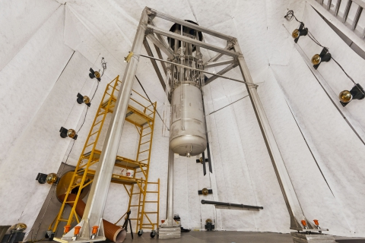
Applications of HPC in Physics
Astronomical/cosmological data
Detection Experiments
LUX (Large Underground Xenon) experiment at USD looking for dark matter
IceCube – Neutrino Detection
Simulations, models
LUX Experiment – Lead, SD

Slide 34

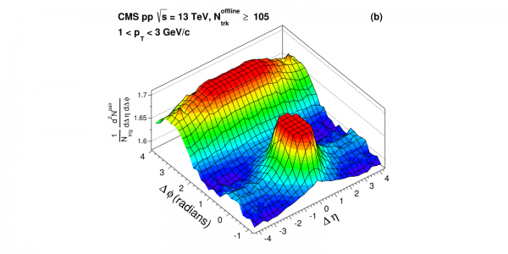
Applications of HPC in Physics-Cont.
Root
Big data processing, analysis, visualization
Geant4
Toolkit using monte carlo methods
Agostinelli, S., et al. (2003). GEANT4—a simulation toolkit. Nuclear instruments and methods in physics research section A: Accelerators, Spectrometers, Detectors and Associated Equipment, 506(3), 250-303.
Antcheva, I., et al. (2009). ROOT—A C++ framework for petabyte data storage, statistical analysis and visualization. Computer Physics Communications, 180(12), 2499-2512.

Slide 35

Applications of HPC in Biology
Sequencing data
Evolutionary questions/modeling
Elucidation of molecular pathways
Phylogenomics (NP hard)
Applications in population modeling, epidemiology
Explorative Data Mining
gene clustering (FCM), gene ontologies

Slide 36

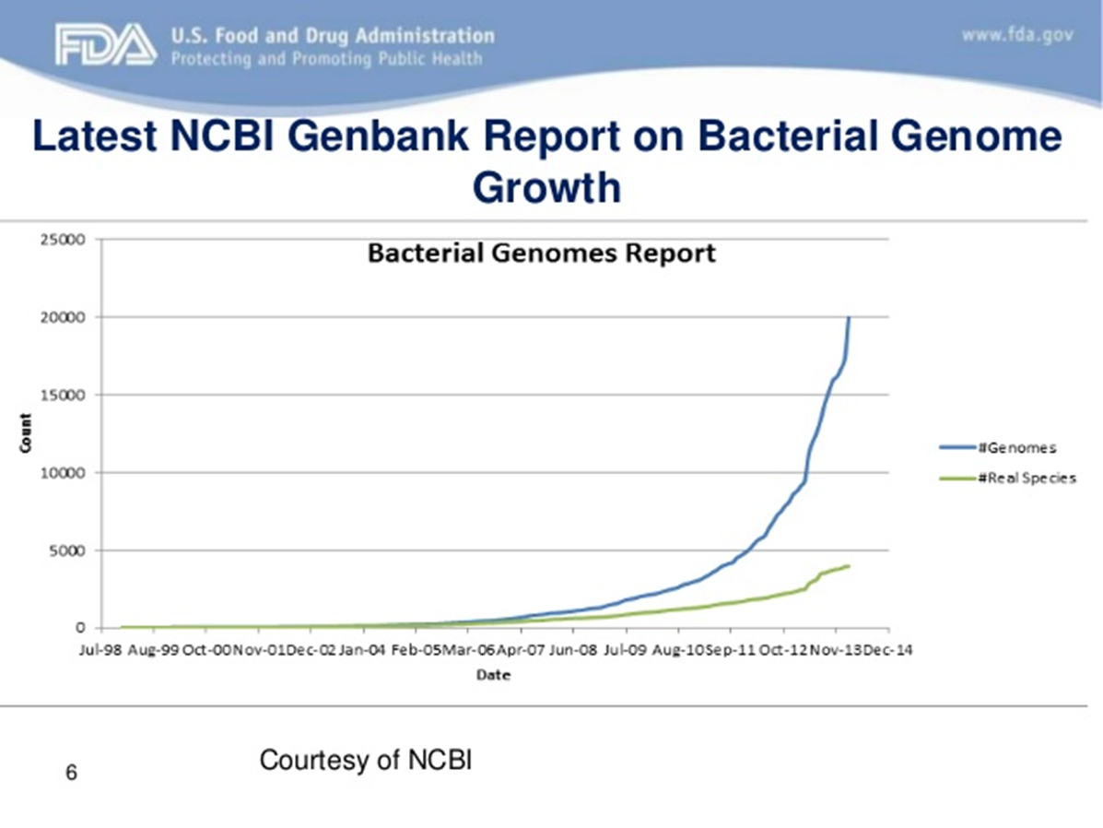
Applications of HPC in Biology-Cont.
Can use R for parallel computing on HPC
SNOW(fall), others
Baele, G., & Lemey, P. (2013). Bayesian evolutionary model testing in the phylogenomics era: matching model complexity with computational efficiency. Bioinformatics, btt340.

Slide 37
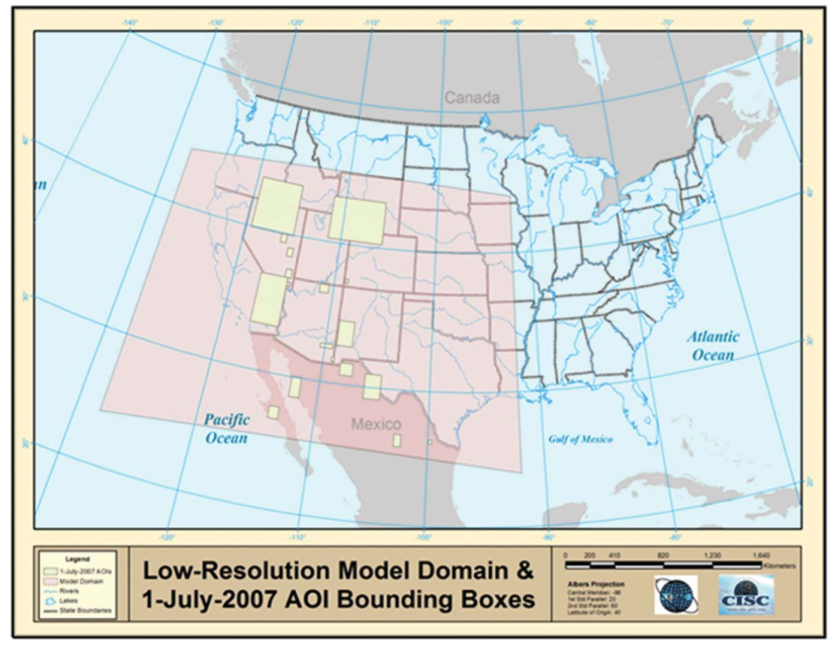
Other Applications
GIS (Geographic Information System) problems
Research in humanities, social sciences
Sandstorm!
Everyone take cover!
Huang, Q., Yang, C., Benedict, K., Rezgui, A., Xie, J., Xia, J., & Chen, S. (2013). Using adaptively coupled models and high-performance computing for enabling the computability of dust storm forecasting. International Journal of Geographical Information Science, 27(4), 765-784.
Notes:
GIS and HPC, duststorm forecasting

Slide 38
In Case you Missed it…
NSF Major instrumentation grant for new supercomputer
Lawrence will come online May/June
New opportunities
Visualization
More power and speed!
XSEDE-Jetstream access
Free Matlab!
Notes:
Auto updates of software, other fancy things (give out packets!)

Slide 39


Resources for YOU!
GitHub Group – USDRCG
https://hpcc.okstate.edu/content/hpc-education-resources
https://www.xsede.org/home

Slide 40
Questions?
Notes:
Poll Title: Feedback/Questions https://www.polleverywhere.com/free_text_polls/V8HXy3Df3XlnxT0

